Slide 1
SALES & FINANCIAL PERFORMANCE DASHBOARD
Data Analyst Internship – Task 4
Interactive Business Dashboard using Power BI
Dataset: Financial Sales Dataset
Tool: Microsoft Power BI

Slide 2
OBJECTIVE
Design an interactive dashboard for business stakeholders.
Monitor sales and profit performance.
Analyze sales trends over time.
Compare regional performance.
Analyze customer segments and top products.
Enable interactive analysis using slicers and filters.

Slide 3
DATASET
TOOLS
Dataset contains:
Date
Region
Country
Product Name
Company Names
Units Sold
Unit Price
Total Sales
Cost of Goods Sold
Profit
Discount
Customer Segment
Tools Used:
Microsoft Power BI — Dashboard development and visualization
Microsoft Excel — Dataset source
PowerPoint — Project presentation

Slide 4
KPI Summary
KPI | Value
Total Sales | 264.07M
Total Profit | 99.36M
Total Units Sold | 5M
Total Cost | 164.71M
KPI Purpose
Total Sales – Measures overall revenue generated.
Total Profit – Shows the financial profit generated.
Total Units Sold – Represents the volume of products sold.
Total Cost – Shows the total cost associated with sales.

Slide 5
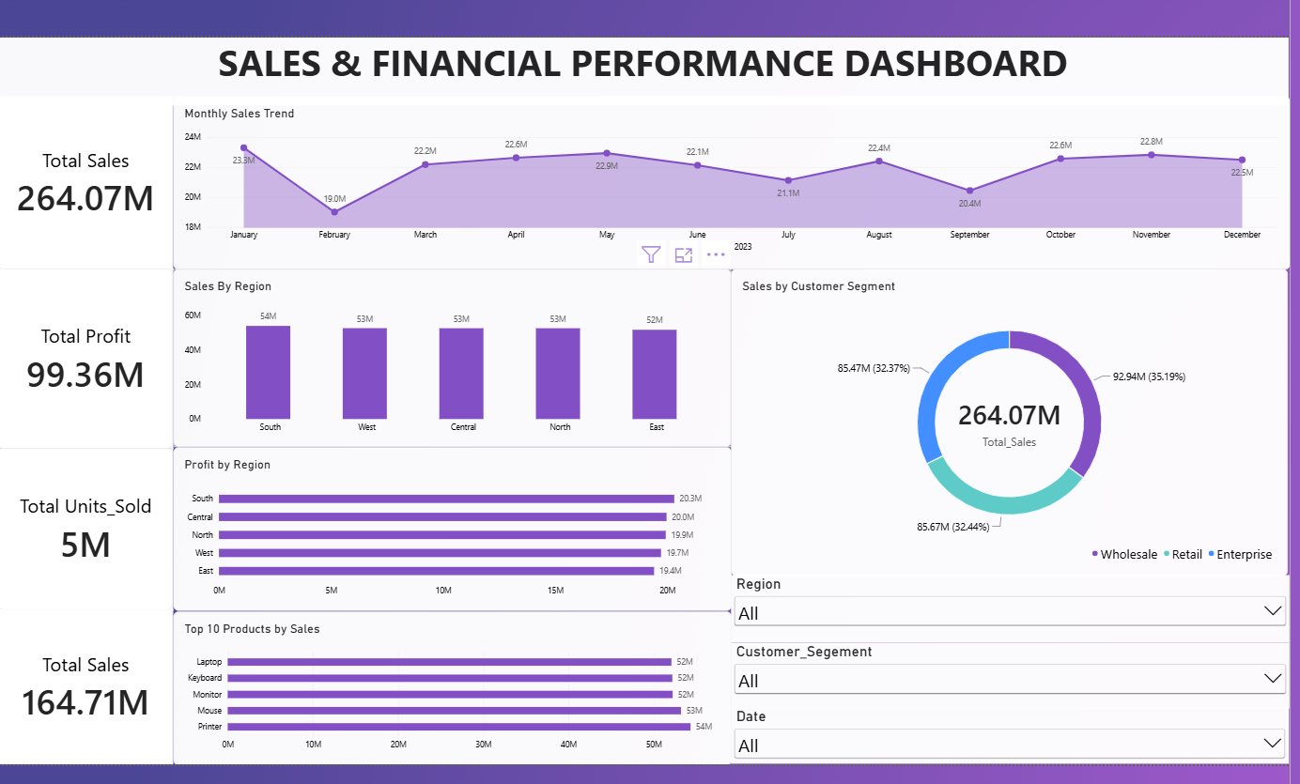
INTERACTIVE DASHBOARD
KPI Cards
Monthly Sales Trend
Sales by Region
Profit by Region
Sales by Customer Segment
Top 10 Products by Sales
Interactive Slicers

Slide 6
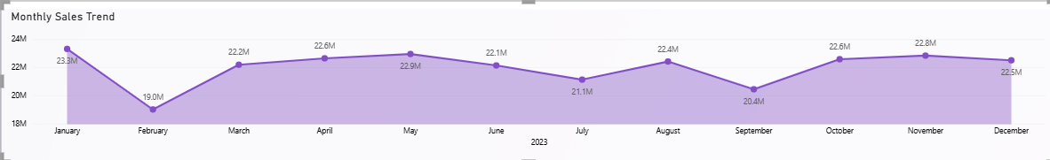
SALES & PROFIT TREND ANALYSIS
The monthly sales trend provides a time-based view of sales performance. It helps identify changes in sales over different periods and supports monitoring of overall business performance.
Key Analysis
Monthly sales performance can be monitored.
Higher and lower sales periods can be identified.
The trend helps stakeholders understand sales movement over time.
The dashboard can be filtered using the Date slicer.

Slide 7
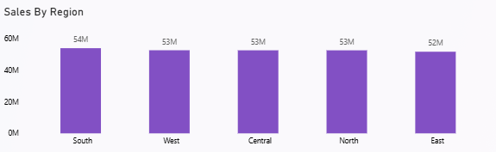
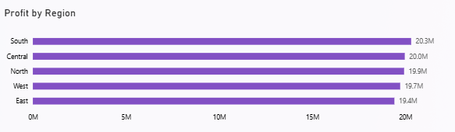
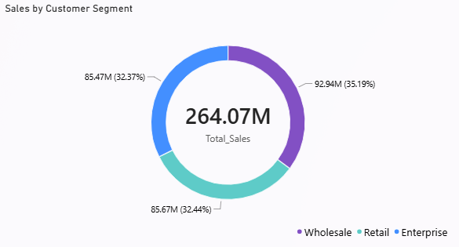
REGIONAL & CUSTOMER ANALYSIS
Regional Analysis
Compares sales performance across different regions.
Helps identify regions contributing to overall sales.
Profit by region provides an additional view of regional financial performance.
Customer Segment Analysis
Shows how total sales are distributed across customer segments.
Helps stakeholders understand which segments contribute to sales.

Slide 8
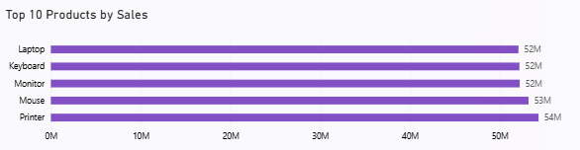
TOP PRODUCTS & INTERACTIVE FILTERS
The Top 10 Products analysis identifies the products contributing the highest sales. Interactive slicers allow users to filter the analysis based on region, customer segment, and date.
Product Analysis
Identifies the highest-selling products.
Helps compare product-level sales performance.
Supports better understanding of product contribution.
Interactive Filters
Region
Customer Segment
Date

Slide 9
Conclusion
The Sales & Financial Performance Dashboard provides an interactive view of business performance using Power BI. It combines key financial KPIs, time-series analysis, regional performance, customer segmentation, product analysis, and interactive filters to support data-driven decision-making.
Key Takeaways
Sales and profit performance can be monitored using KPI cards.
Monthly trends help analyze sales performance over time.
Regional analysis helps compare sales and profitability.
Customer segmentation provides insights into customer contributions.
Top 10 product analysis highlights high-performing products.
Slicers allow users to interactively filter the dashboard.
“Turning sales data into actionable business insights.”

